Slide 1
ShieldAlpha
The AI Based Personal Trainer

Slide 2
ABSTRACT
ShieldAlpha "AI-Based Personal Trainer with Real-time Form Tracking" is a fitness program designed to revolutionize the way individuals engage with their workouts
The system employs MediaPipe's landmark detection capabilities to track the user's body movements during workouts, ensuring that exercises are performed with precision.
This project is performed with the help of the open cv Library which means Open-source computer vision library it is a software library of open-source machine learning and computer vision for image processing and video processing & also for CNN

Slide 3
KEY FEATURES
Form Tracking – Using MediaPipe API the users body is tracked and using the land marks by the API a logic is created which tracks the form of the performed exercise
Audio Output – An Audio Output is provided on how to perform the exercise and more details. User also gets the rep counts as an Audio output
Exercise GIF – And .gif image of the exercise to be performed is also shown side by side the tracking window.

Slide 4
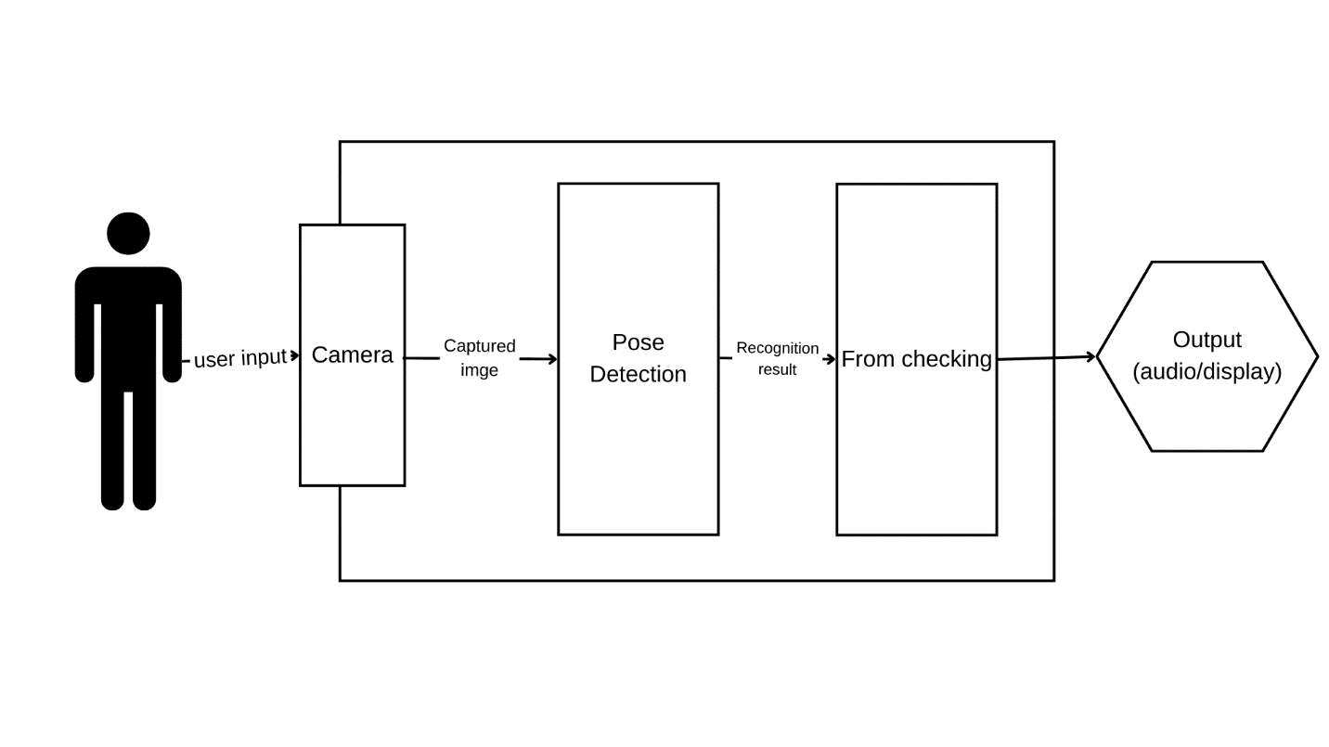
RESEARCH METHODOLOGY
Research Objective
Literature Review
Proposed Model
Real-time Form Tracking

Slide 5
RESEARCH METHODOLOGY
There are many ways to train the model few are mentioned below
1. using viola jones algorithm to track body key points
2. using mediapipe to train workout videos and using this model to check the form of exercise
3. using mediapipe to draw the landmarks and creating logic to check the forms
4. using opengl and mediapipe together we can estimate pose and using open gl we can draw landmarks and create the logic for checking form

Slide 6
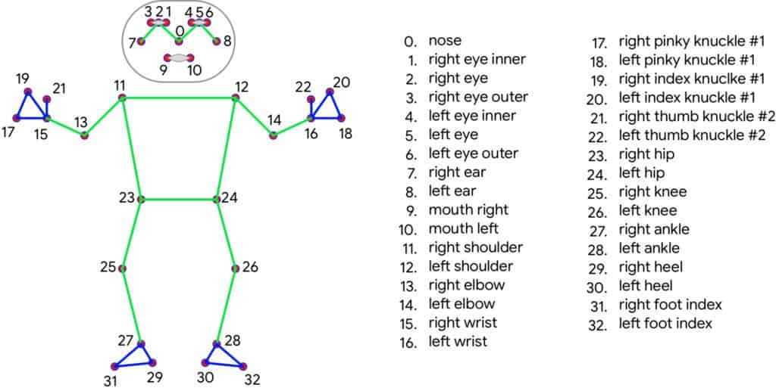
RESEARCH METHODOLOGY
import python module
detection of human body
extracting joints co-ordinates using media pipe mose module
calculation of angle
condition to verify how good the form is
output as display or audio message
Proposed Methodology Framework

Slide 7
EXPERIMENTAL SETUP
HARDWARE AND SOFTWARE SETUP - For hardware we have used computer and the default camera to take live video input
PROGRAMMING LANGUAGE- Python for backend. Html, Javascript, Flask for the frontend or GUI
USER INPUT AND POSE ESTIMATION - OpenCV to capture image and Mediapipe for Pose Estimation
WINDOW DISPLAY - PyQt5 library was used to display the gif window
AUDIO - Speech recognition is used to take audio input and Google text-to-speech library and pygame library was used for the audio output

Slide 8
TESTING REPORT
The application can estimate the poses and count repetitions for a limited number of exercises.
The application is limited with single-person compatibility at a time.
The accuracy of pose estimation model can be affected by various aspects such as poor lighting, poor video quality and the camera needs to be positioned correctly before tracking

Slide 9
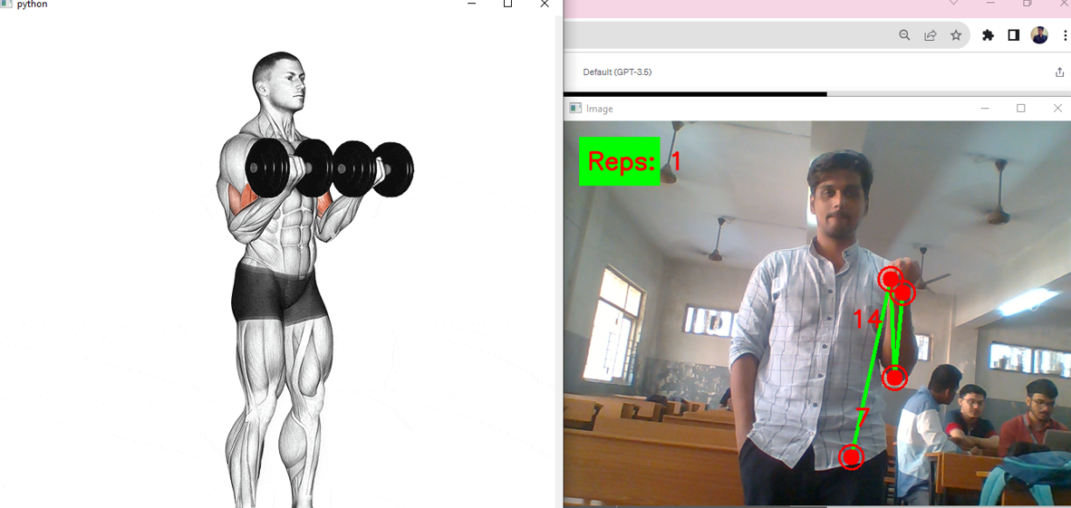
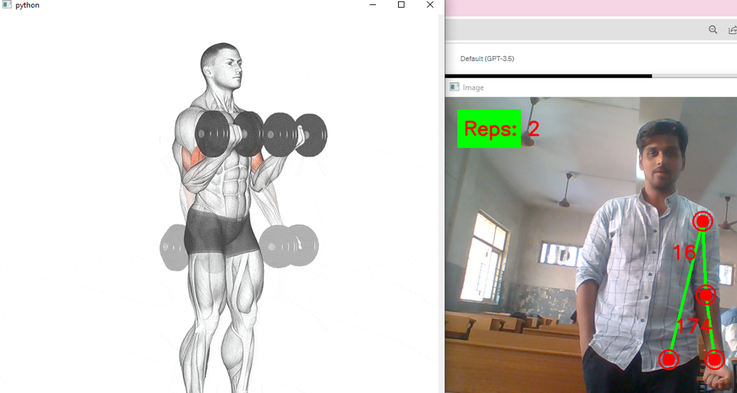
BicepCurls

Slide 10
FUTURE ENHANCEMENT
In future this project can be improved by adding more exercises and also adding workout generator and diet generator modules. This Program can also be implemented as mobile application so that the user finds it easier to use and operate. Further, my work can also be enhanced by introducing real time voice assistant to the user so that the user can follow those instructions provided by voice assistant in live workout session and do workouts more accurately. Mediapipes holistic model can be used to authenticate the user and track only the registered users body

Slide 11
THANK YOU

